Slide 1






DFAs $→$Regular Expressions
Recall Theorem: If $R$ is a regular expression and $A=L\left(R\right)$ then $A$ is regular
Proof: Conversion $R$ $→$NFA $M$ $→$ DFA $M′$
$$M$$
Regular expression $R$
Finite automaton
Recall: we did ${\left(\text{a}+\text{ab}\right)}^{∗}$ as an example
Today’s Theorem: If $A$ is regular then $A=L\left(R\right)$ for some regular expr $R$
Proof: Give conversion DFA $M$ $→$ $R$
WAIT! Need new concept first.

Slide 2











Generalized NFA
Definition: A Generalized Nondeterministic Finite Automaton (GNFA) is similar to an NFA but allows regular expressions as transition labels.
$$G1$$
$${\text{a}}^{∗}{\text{b}}^{∗}$$
ab
For convenience we will assume:
- One accept state, separate from the start state
- One arrow from each state to each state, except
a) only exiting the start state b) only entering the accept state
$∅$ (empty input) does not change the language but fulfill the assumptions.
We can easily modify a GNFA to have this special form.
$$q1$$
$$q2$$
$$\text{ε}$$
$$∅$$
$$\text{a}+\text{b}$$
aab
$$q3$$
$$q4$$
$$\text{ε}$$

Slide 3







GNFA $→$Regular Expressions
Lemma: Every GNFA $G$ has an equivalent regular expression $R$
Proof: By induction on the number of states $k$ of $G$
Basis $(k=2)$:
Let $R=r$
Induction step $(k>2)$: Assume Lemma true for $k−1$ states and prove for $k$ states
IDEA: Convert $k$-state GNFA to equivalent $\left(k−1\right)$ -state GNFA
$$G=$$
$$r$$
Remember: $G$ is in special form
GNFA
GNFA
$k$ states
$k−1$ states

Slide 4











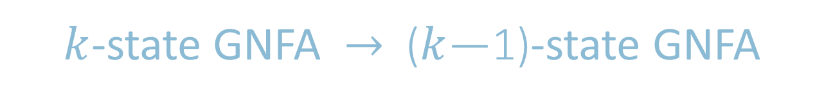




$k$-state GNFA $→$ ($k$—1)-state GNFA
$$x$$
$$r_{2}$$
$$x$$
$$r_{1}$$
Pick any state $x$ except the start and accept states.
Remove $x$.
Repair the damage by recovering all paths that went through $x$.
Make the indicated change for each pair of states $q_{i}, q_{j}$ .
$$r_{3}$$
$$q_{i}$$
$$q_{j}$$
$$q_{i}$$
$$q_{j}$$
$$r_{4}$$
$$r_{1}{\left(r_{2}\right)}^{∗}r_{3}+r_{4}$$
$k$ states
$k−1$ states
Every GNFA $G$ has an equivalent regular expression $R$
Thus, DFAs and regular expressions are equivalent.

Slide 5
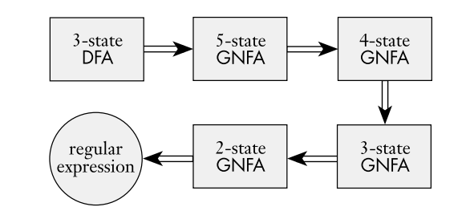
Typical stages in converting a DFA to a Regular Expression
For example, the stages in converting a DFA with three states to an equivalent regular expression:
Notes:
Three state DFA -> 5 states GNFA: Because we get two new states, which are the start and final states.

Slide 6
DFA to Regular Expression
a
a*
a
a
q₀
➔
a*
q₀
q₁
q₂
➔
q₀
aa
q₂
q₀
➔
➔
aa
a, b
(a+b)*
a
q₀
➔
q₀
(ab)*
➔
(a+b)*
q₀
q₁
q₀
➔
b
➔
(ab)*

